Slide 1

Your new travel buddy
G8 Kwang Wei, Emma, Nora, Hsu Hwee, Kar Mun
https://www.youtube.com/watch?v=X951zfpVITk

Slide 2
Overview
1. Objective
2. Functionalities
3. Tech Stack
4. APIs used
5. Beyond the Lab
6. Website Demo

Slide 3
Problem Statement & Objectives
Problem Statement: How can we help travellers plan their trips more efficiently without visiting multiple websites?
Objectives:
1. Increase Efficiency and Reduce Planning Time
Our web application will be a centralised solution for users to eliminate the need to visit multiple websites for their trip planning needs.
2. Provide real-time updates on travel aspects like weather conditions and budget tracking.

Slide 4
Functionalities
1
2
3
Budget Tracking
Itinerary Builder
Weather Forecast
Users can set custom trip budgets, update expenses, and track if they stay within budget.
Users can plan destinations and explore attractions to create a personalized itinerary.
Users are able to retrieve weather forecast for the days they are travelling in their set destination..

Slide 5
Functionalities
4
5
Currency Converter
Find Attractions
Users are able to retrieve real-time exchange rate data.
Users are able to seek inspiration on places to visit using our “Find Attractions” function.

Slide 6






Tech Stack
Frontend
Backend
Google Firebase, Javascript
HTML5, Vanilla CSS Javascript, Bootstrap, Vue.js
- Authentication - Firestore

Slide 7




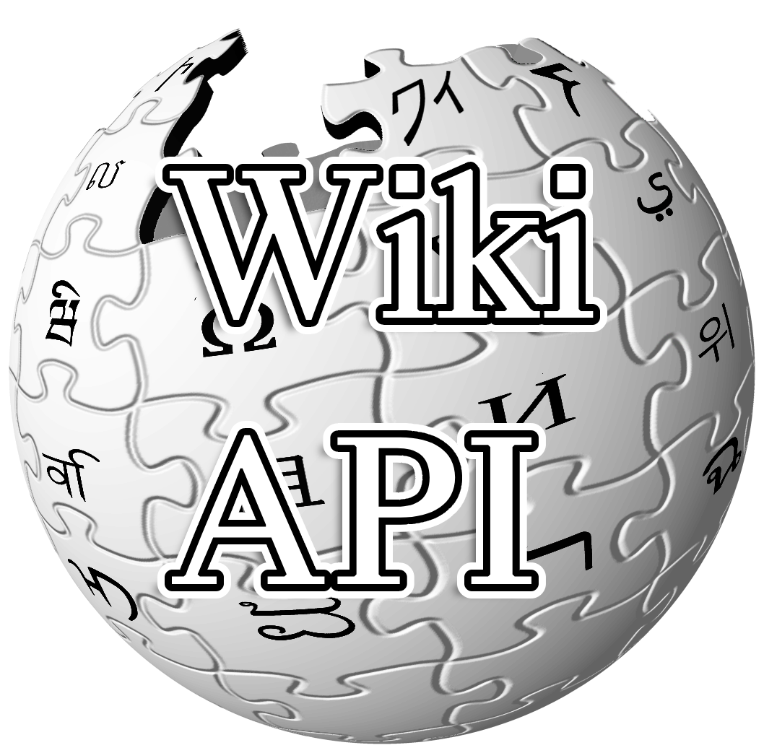
APIs used
OpenWeatherMap
API
Real-time weather data based on locations
Google Maps & Places API Real-time location data, including attractions
Unsplash Image
API Open collection of high-quality photos
Fixer API Real-time currency exchange rates
Wiki API Provides brief description of locations

Slide 8

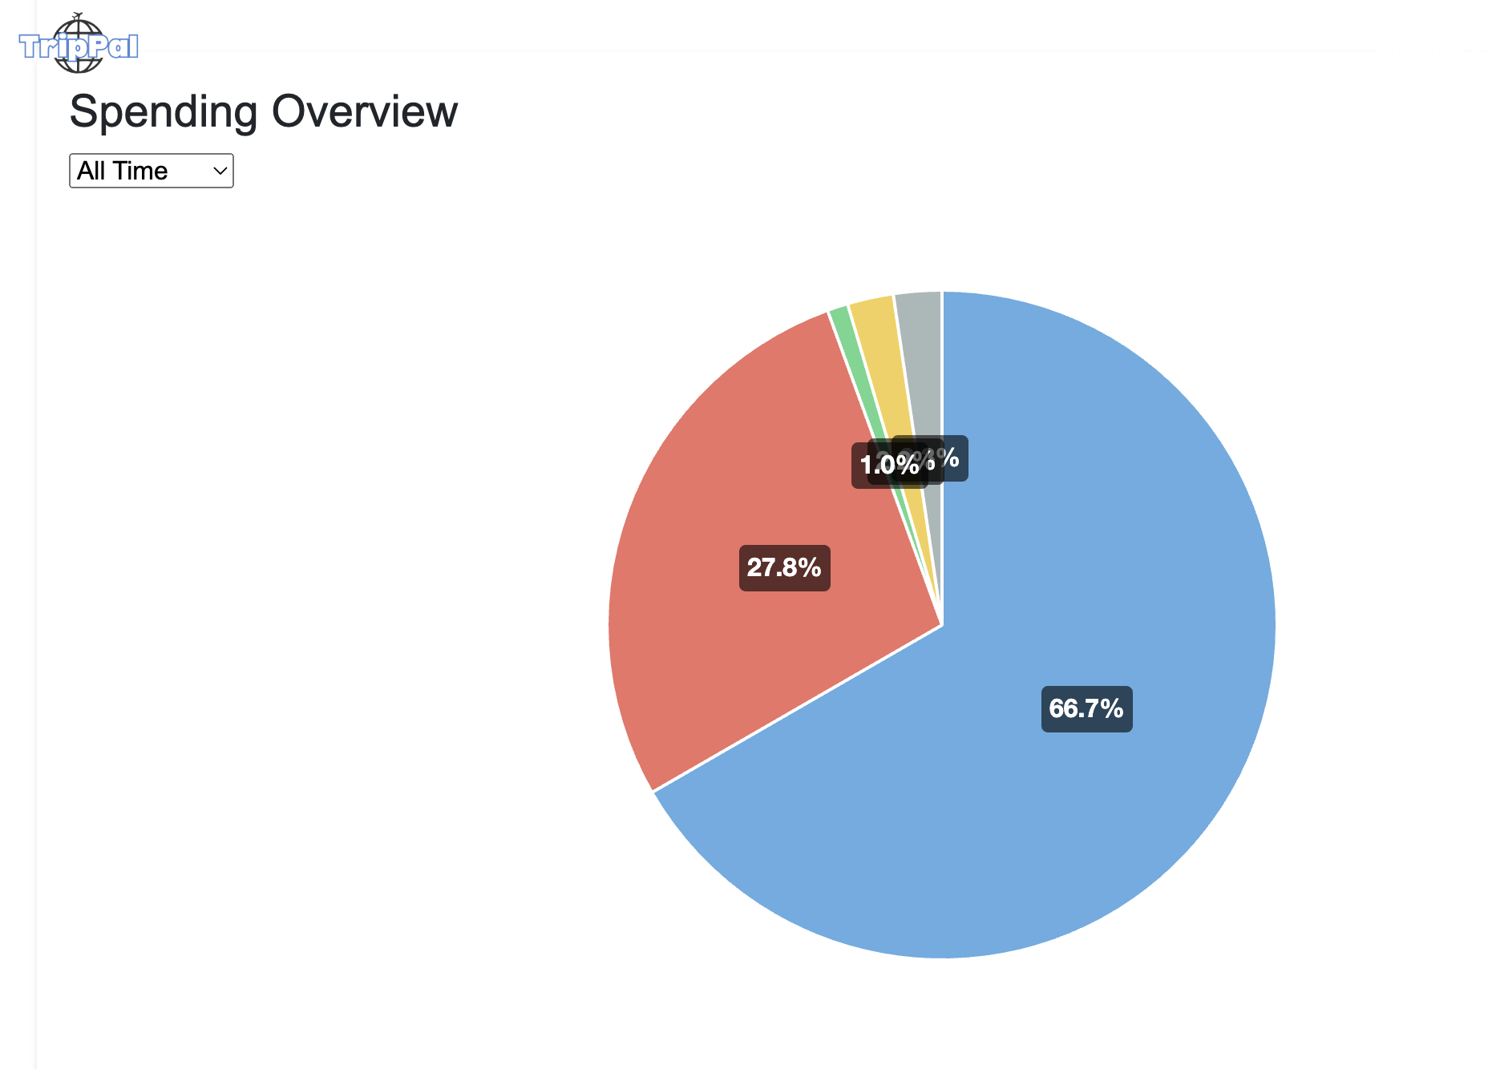
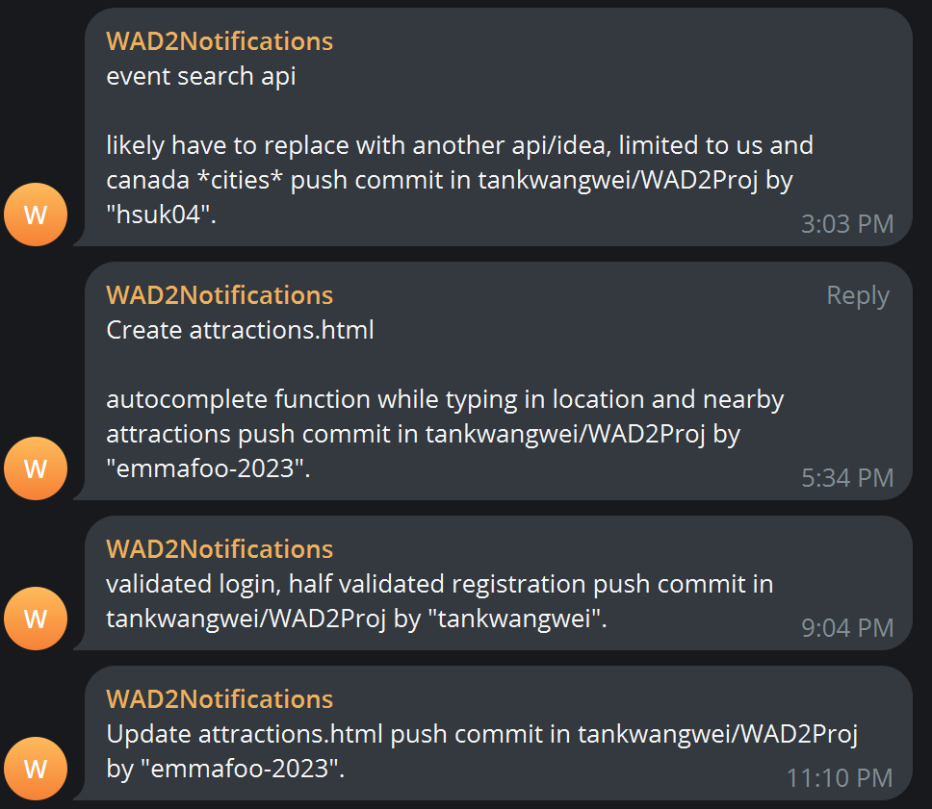
Beyond the Lab
Github Collaboration Track changes via version control and push pull requests
CI/CD through telegram notifications
Visualisation
Library
Chart.js used to generate dynamic pie charts in our budget tracker

Slide 9
Website Demo
Presenting TripPal

